Slide 1


Social Buzz

Slide 2


Today's agenda
Project recap
Problem
The Analytics team
Process
Insights
Summary

Slide 3

An audit of their big data practice
Recommendations for a successful IPO
An analysis of their content categories that highlights the top 5 categories with the largest aggregate popularity
Project Recap

Slide 4
Problem
To Determine Top 5 Content Categories For “Social Buzz”

Slide 5



Jayant Singh Jhala
(Data Analyst)
The Analytics team
Marcus Rompton (Senior Principle)
Andrew Fleming (Chief Technical Architect)

Slide 6
Process
Selected Relevant
Data Sets
(Reactions, ReactionsType and Content)
1
2
Cleaned and Preprocessed
the Data Sets
3
Merged The Data Sets
4
Grouped Data by Categories
and Summed the Scores Accordingly
5
Obtained Top 5 Popular Categories By Visualizing the Valuable Insights

Slide 7
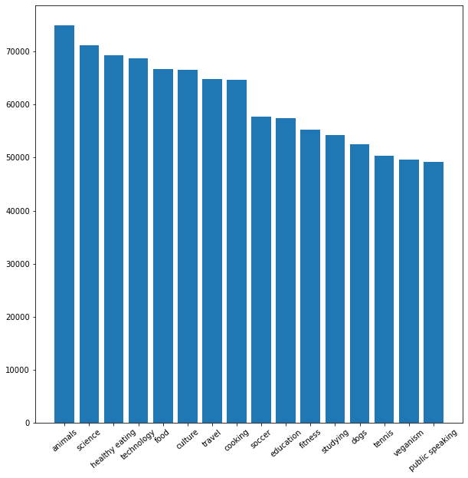
Insights
Unique categories ?
➔16

Slide 8
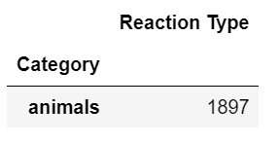
Insights
Reactions on the most popular category?

Slide 9
Insights
The month with the most posts?
➔May⬅

Slide 10
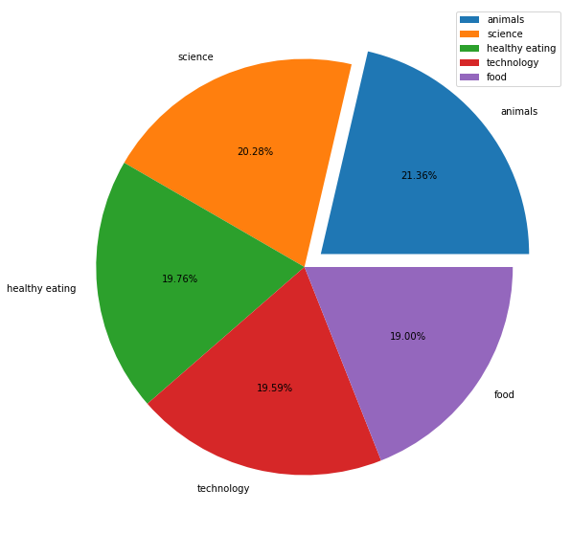
Insights

Slide 11
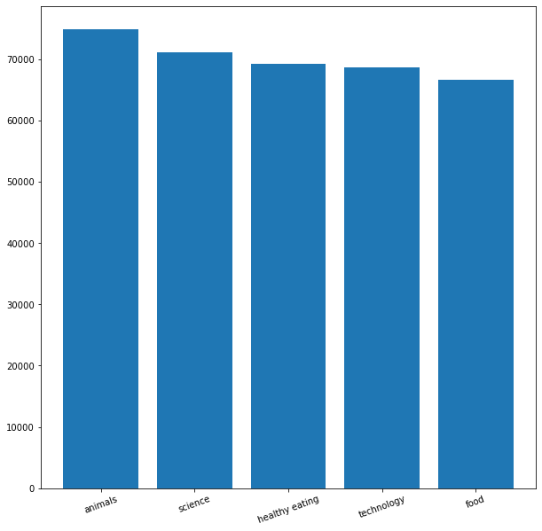
Insights

Slide 12
ANALYSIS
Animals and science are the two most popular categories of content, showing that people enjoy "real-life" and "factual" content the most.
INSIGHT
Food is a common theme with the top 5 categories with “Animals" ranking the highest. This may give an indication to the audience within your user base. You could use this insight to create a campaign and work with healthy eating brands to boost user engagement.
NEXT STEPS
This ad-hoc analysis is insightful, but it's time to take this analysis into large scale production for real-time understanding of your business.
Summary

Slide 13
Thank you!
ANY QUESTIONS?

